Slide 1


Why the Cookie Progam is Important?
It’s More Than Money
Girls develop lifelong skills to successfully navigate through life.
The Five Skills
Decision Making: Critical Thinking and Problem Solving
  What to do we want to do?
  A long or short term goal?
  Fun or educational? A little bit of both?
Goal Setting: Cooperation and Team Building
  Goals to accomplish what girls want to do for the year.
  Broaden travel goals.
  One year goal to visit Disneyland; 5 year goal to visit New York City

Slide 2
Why the Cookie Progam is Important?
Money Management: Practical Life Skills
  Counting boxes
  Making change
  Creating a budget and business plan
People Skills: Healthy Relationships and Conflict Resolution
  Talking to customers
  Learning to articulate
  Learning that it’s okay if a customer says, ‘no thank you’
Business Ethics: Positive Values
  Philanthropy and supporting her Council
  Communication and inventory Management
  Customer appreciation
  Our Neighborhood Cookie Rally: Friday, January 8th 6:00-8:00 at Mountainside Middle School

Slide 3
Cookie Contests- Tools to Promote the Program
Cookies Worth Sharing: Girl Guided Training Challenge. Earn a chance to sell cookies at the Cookie Kick-Off on January 9 at the GCU. Entries due December 14.
Flat Stacie Collage Contest: What does selling cookies look like to you? Experience the cookie sale with your friend, Flat Stacie! Share your story with your sister Girl Scouts and enter into a raffle to win tickets to a fun spring festival. Entries due February 28.
Cookies on the Go: Send us a picture of you decked out wagon, scooter, stroller or anything without a motor. Entries due March 9.
Mystery House: There is a ‘Mystery House’ hidden in every Service Unit. The first girl who finds the house on her walkabout will win a Mystery Prize!
Bling Your Booth: Send us a picture of your blinged out Cookie Booth to enter the contest. Entries due March 9.
Mighty Mints Club: Sell 2000+ packages of cookies and receive special recognition at the 1000+ super sellers event along with a one-of-a-kind trophy. C’mon, join the club!
For more information visit our website at:
http://www.girlscoutsaz.org/en/cookies/cookie-contests-events.html

Slide 4

What’s New This Year
Digital Cookies
Initial Order due December 15!
Savannah Smiles are back
Troops cannot turn in a Parent Guardian Outstanding Balance Form in for unpaid balances of more than 120 packages.
Toffee-tastic orders
Service Unit Bonus
Troop-to-Troop Transfer Link

Slide 5
Cookies Now!
Girls can begin selling with cookies on hand on January 18.
Girls should not take pre-orders or sell before January 18!
Girls can announce that cookies are coming.

Slide 6
Troop Success!
Hold Cookie Meetings:
  Girl Meeting: Let girls decide their goals and develop an action plan to sell cookies.
Parent Meeting: Discuss cookie inventory and communication, Girl Program, girl safety and financial responsibility.
The Cookie Manual is great resource to help develop Parent and Girl cookie meetings.
Product Program Parent/Guardian Permission and Financial Responsibility Agreement is signed for each girl and kept on file with the troop.
Notes:
Troop Leaders and Cookie Managers can use the Cookie Manual for specific topics to discuss at meetings. Little Brownie Bakers is also a great source for information to share with parents and girls.
Troops need to emphasis cookie inventory management and communication tools with the parents/guardians.

Slide 7
Troop Success!
What girls need to do to participate in the Cookie Program:
Girls must be registered for the current Girl Scout season. This year, troops will not be able to add girls to eBudde.
Girls’ families have signed a Product Program Parent/Guardian Permission and Financial Responsibility Agreement (good for both Fall Product and Cookies).
Girls and her Parent/Guardian have agreed to communicate cookie inventory status with Troops and turn money in weekly.
Notes:
Troop Leaders and Cookie Managers can use the Cookie Manual for specific topics to discuss at meetings. Little Brownie Bakers is also a great source for information to share with parents and girls.
Troops need to emphasis cookie inventory management and communication tools with the parents/guardians.

Slide 8
Selling Cookies!!!
Sale Dates:
January 18- February 28
Girls may promote the Cookie Sale prior to January 18 (i.e. Cookies are Coming…)

Slide 9
Two Gift of Caring Programs
Council Gift of Caring
A ‘virtual’ Gift of Caring option; Council handles all the details.
Purchases are recorded and money is collected at the time of purchase.
Troop Product Managers record the transaction in the C_GOC column in eBudde.
Council donates cookies to:
  Local Food Banks including St. Mary's Foodbank, St. Vincent de Pauls, and United Foodbank.
  The USO and Packages from Home
Troops do not take possession of the product; Council handles cookie distribution.

Slide 10
Two Gift of Caring Programs
Troop Gift of Caring
Troops select a non-profit organization they would like to support.
Troop Product Manager contacts the organization to verify they can accept the cookies.
Troops use unsold inventory at the end of sale to fill Gift of Caring orders.
If Troops need additional product to fulfill order:
  Troops should check girl inventory.
  Troops should check troop to troop transfer link.
  Pick up additional cookies from the cupboard.
Troop Product Managers record the transaction in the T_GOC column in eBudde.
Troops handle cookie distribution.

Slide 11
Digital Cookies Girl Program Overview
Parents will receive an email inviting them to register their daughter for the program.
Parents need to register girls for the program.
Girls 13 and over must a have a separate email account.
All girls and volunteers must watch the safety video.
Parents must sign the terms and conditions.
Girls and parents must read the cookie pledge. Girls 13 and over will be sent a copy of the pledge.
Girls will set up her website, enter her goals, enter customers, work on age appropriate Cookie Badges, learn about email marketing cycles, test her cookie knowledge, create a marketing video, and much more!

Slide 12
Digital Cookies Volunteer Overview
Troop Leaders and Parents are sent a registration email about Digital Cookies. Volunteers with multiple roles can switch between them.
Digital Cookies are shipped directly to the customer from the Bakery.
Once an order has been placed and the payment clears, the information is sent to eBudde for troop records. There is nothing else the troop leader needs to do. DOC amounts are treated as a deposit for the full sales prices of the cookies. Council will cover the credit card fees for DOC cookies.
Minimum order for shipped cookies is 4 boxes. Shipping and handling will be applied.
For more information on Digital Cookies, please see the website for additional webinars.

Slide 13
Booth Guidelines
Be polite:
Do not booth before January 18, 2016.
Cancel your booth in eBudde if you can’t make it!
Do not wear or bring competitor store items with you.
Don’t bring a Trader Joes bag to Fry’s.
Check in with the store manager when arriving and leaving.
Follow store set-up rules.

Slide 14
Booth Guidelines
Appoint someone to safeguard the cash box.
Fanny bags may be preferable to a cash box.
No more than $100 in the cash box.
Do not accept bills over $20. Council will not replace counterfeits over $20.
Two adults and two girls at a booth.
No more then 4 girls at a booth at a time.
Notes:
.

Slide 15
Booth Guidelines
Do not arrive more than 5 minutes before your shift and do not stay after your shift.
Siblings/friends are not allowed.
Wear Girl Scout identification.
Do not allow girls to shout at customers.
Clean your area when you leave.
Leave a thank you card with the manager.

Slide 16
Emergency???
Follow the instructions on the MS-27 Emergency Card.
Care for the immediate needs of the victim.
Secure help, call 911.
Contact your Troop and/or SU Product Manager if needed.
Contact Council at 602 452 7000. After hours call the emergency line at 602 531 5935.
Do not issue statements to the media.
Do not post statements on social networking media.

Slide 17
Cookie Finder: Important reasons to enter ALL booths into eBudde!
Customers looking for cookies will directed to the nearest cookie booth.
We use this information to impress the stores who support our cookie booths.
All you have to do is enter your booths into eBudde.

Slide 18
Placing an Initial Cookie Order
Adjusting for girl participation, established troops should place an order based on 80% of last year’s sale.
New troops should place an 80% order based on the per girl average for their age group.
All troops should make a healthy initial order to avoid council wide inventory shortages.

Slide 19
What About Toffee-Tastic?!
Toffee-Tastic is the gluten-free cookie that GSACPC is offering.
Troops were invited in September to put in an order for Toffees. They are responsible for the amount ordered and it will be uploaded into eBudde by the Product Program Team. Troop will not be able to add or subtract from the number preordered.
We will have a limited amount of Toffee-tastics at ONLY the Council Warehouse, but preference will be given to NEW TROOPS and IGMs.

Slide 20

Initial Troop Cookie Order Reward
Troops who have a PGA of 160 or more on their
initial order will earn a t-shirt.
1 shirt per girl
1 free adult shirt per troop
Up to 3 additional adult t-shirts may be ordered on eBudde at time of initial order
Additional t-shirts are $6.00 each and will be debited from the with the first ACH on February 11.

Slide 21
Initial Troop Cookie Order Reward
Troops must place the initial reward order into eBudde.
Each girl selling must be assigned one package of cookies in eBudde under the initial order tab to be eligible for the initial order reward.
Troops who do not enter the initial order reward forfeit the t-shirt reward.
There will be NO ADDITIONAL shirts available through Council for adults or girls.
All t-shirt orders must be entered into eBudde at the initial order or the t-shirt reward will be forfeited

Slide 22

Managing Girl Inventory
Girls and parents must give weekly inventory updates to the troop.
Money must be turned in weekly.
Limit the amount of cookies given to one girl at one time.
Do not give additional cookies to girls without an inventory count and all money owed is turned in.

Slide 23
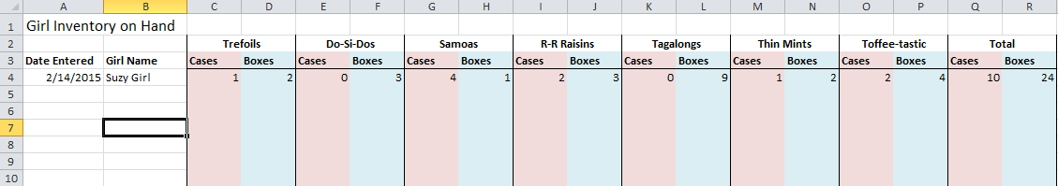
Managing Girl Inventory
Or go Green… use a Google Docs spreadsheet to manage inventory.
Families can access the Google Doc to enter their current inventory.

Slide 24
In Summary, Try These Steps! (in order!)
Steps to Manage Troop Inventory:
Have girls turn in inventory status and cookie money weekly. Do not check out more cookies to a girl until money has been turned in. A girl should never have more than 120 unpaid packages at one time.
Need more cookies:
  First check with parents to see if they have cookies they can’t sell.
  Then, check the Council Troop-to-Troop Transfer Google Doc to see if there are other troops who need to offload cookies.
  If you still don’t have the cookies you need, then visit a cookie cupboard and make a responsible order.

Slide 25
Cookie Cupboard Distribution
Cupboards distribute cookies by cases only (i.e. 12 packages/case)
Cookies cannot be returned.
Unopened and sealed cases may be exchanged for a different flavor
Damaged cases and packages may be exchanged

Slide 26
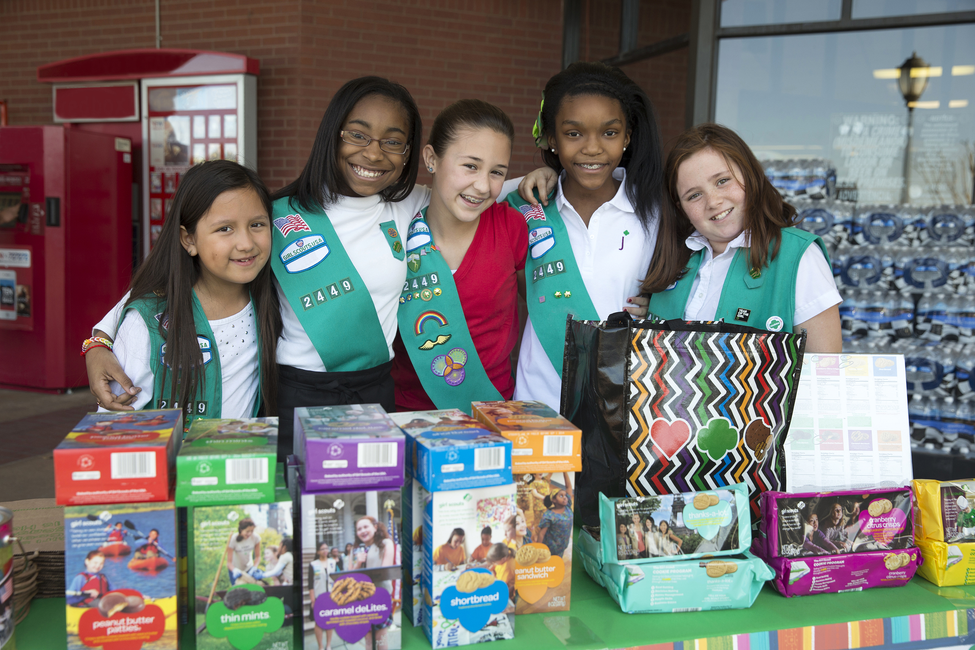
Digital Order Card 2.0
SU/Troop Training
Notes:
Welcome to Digital Cookie 2.0 training.

Slide 27
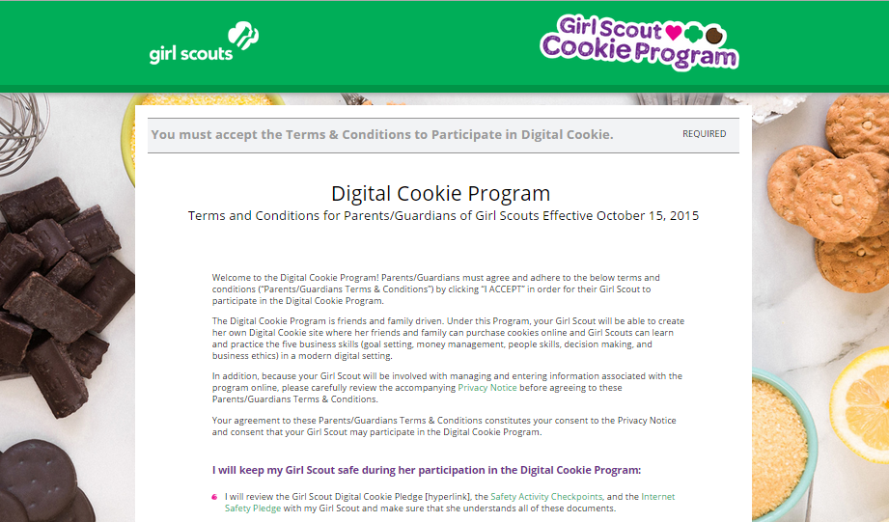
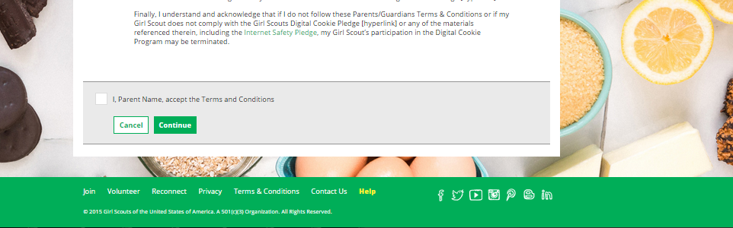
Digital Order Card 2.0
Notes:
UPDATE Screen
Then sign the Terms and conditions. This is only a representation of them.
After this, you would be taken to the SU dashboard

Slide 28
Digital Order Card 2.0
Troop leader/SU registration process
Scenario 1
Adult is a SU Cookie Person, not a parent or leader
Volunteer gets email
Clicks on link to go to digital cookie
Sets password and logs in
Watches safety video (even if no girls)
Signs Terms and Conditions for volunteer
Is taken to the SU Dashboard
Notes:
This is the process an adult volunteer without girls uses to log in to DOC.
Let’s take a look at each of the steps.
No need to commit this to memory, the system walks you through the process every step of the way and it won’t take more than a few minutes.

Slide 29
Digital Order Card 2.0
Troop leader/SU registration process
Scenario 2:
Adult is a parent of a girl over 13 AND a troop leader or SU Cookie Manager
1. User gets the Service Unit registration email (highest level in the hierarchy email only)
2. Clicks on link to go to digital cookie
3. Watches safety video
4. Signs T&C’s for volunteer
5. Signs T&C’s for parent
6. Chooses role from drop down
7. Chooses parent role
8. Registers girl(s)
9. Is taken to the parent dashboard
Notes:
For volunteers (SU or troop) who are also parents, there are a couple of extra steps.
First, we’ll look at it for parents of girls over 13.
The differences between this and the previous scenario are signing an extra T & C as the parent and selecting your role on logging in.
Volunteers who are also parents should login as a parent the first time they login. Let’s take a look.

Slide 30
Digital Order Card 2.0
Troop leader/SU registration process
Scenario 3:
Adult is a parent of a girl under 13 AND a troop leader or SU Cookie Manager
1. User gets the Service Unit registration email (highest level in the hierarchy email only)
2. Clicks on link to go to digital cookie
3. Watches safety video
4. Signs T&C’s for volunteer
5. Signs T&C’s for parent
6. Signs Girl Pledge on behalf of the girls
7. Chooses role from drop down
8. Chooses parent role
9. Registers girl(s)
10. Is taken to the parent dashboard
Notes:
This is almost the identical process as the last scenario, difference is for a volunteer who only has girls under 13. They read and sign the girl pledge with their girl or girl(s) under 13, whereas girls over 13 do that themselves. Everything else is the same.

Slide 31
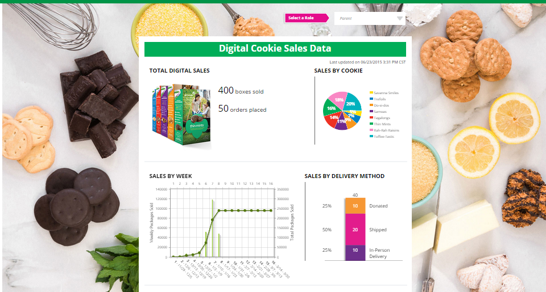
Digital Order Card 2.0
30
Notes:
When you are in, you’ll see this glance at your SU’s metrics. Pay no attention to the graph that shows as many raisin and toffee as mints! I doubt yours will look like that.
Note, if you have multiple roles you can easily switch between them using the role selector at the top. The role selector will be at the trop of all of your pages if you have multiple roles, allowing you to switch between roles..

Slide 32
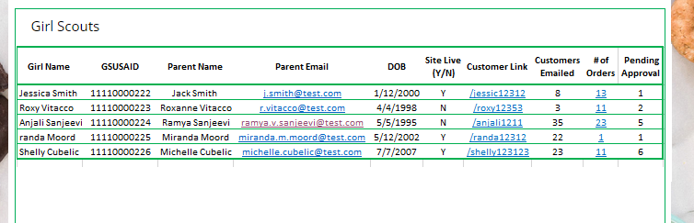
Digital Order Card 2.0
Notes:
Here’s a closer look at what a troop dashboard might look like. Or, an SU dashboard if they had selected a troop.
Everything functions the same for both troop and SU’s. The only difference is how many girls they can see.
In these new dashboards, leaders can do a lot to support their girls in DOC.
They can make sure girls have their site live, and if they don’t leaders can work with the girl and her family to see if she needs support.
Leaders can see if girls are sending out emails to customers and encourage them to send them periodically. She could also see if a girl were perhaps sending out too MANY emails and use it as a teaching opportunity about email spam.
But, the two fields I think will be most utilized are the last two. Let’s look at those.
NOTE-there won’t be any pending approval
The leader/SUCM would click on number of orders column

Slide 33
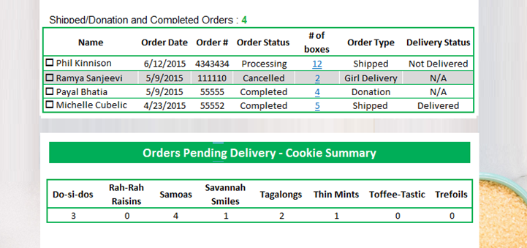
Digital Order Card 2.0
Notes:
Clicking on the orders will bring up a screen like this that allows the leader to see what orders the girl has had and the status of them all.

Slide 34
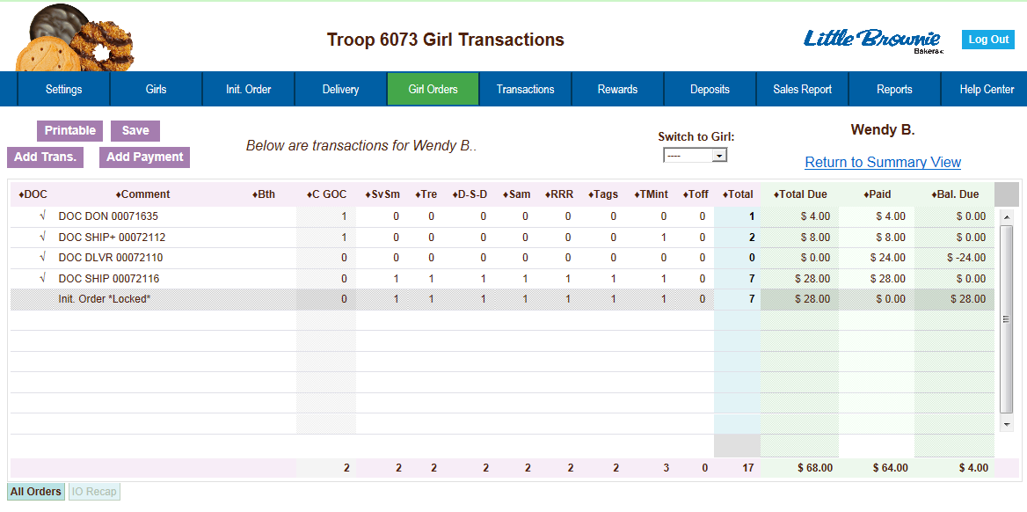

Digital Order Card 2.0
Notes:
Once an order has been placed and the payment clears, the information is sent to eBudde for your troop records. It will appear on the girl orders page as both whatever kind of cookies they ordered and how much money was deposited. There is nothing more the leader needs to do except adjust the amount she needs to deposit because the DOC amount is treated as a deposit for the full sales price of the box. (See next slide for example)
It should be noted that the minimum order for shipped cookies is actually 4 boxes. This screen is not an accurate representation of the minimums for shipping.

Slide 35
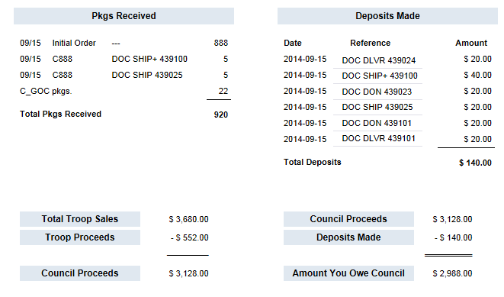
Digital Order Card 2.0
eBudde Sales Report
Notes:
Sales report
You can see how the transactions will be reflected on the sales report in ebudde and troops will adjust their deposits accordingly.

Slide 36
Digital Order Card 2.0
Girl (parent) gets registration email
Girl sets up site
Parent approves and publishes it
Girls build their customer list and send marketing emails
Notes:
Setting up a site is great, but then she has to actually publish it and send it out to customers.

Slide 37
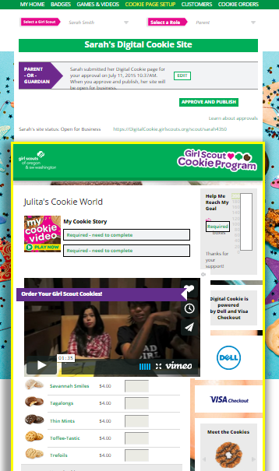
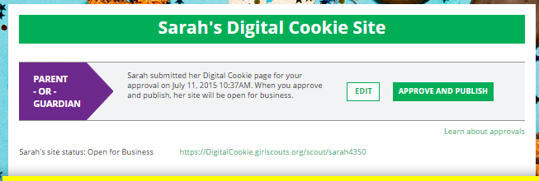

Digital Order Card 2.0
Notes:
This is the preview of the site (on the left).
Parents can edit from here and/or approve it.
Great. The site is ready. Now what? Lets get some customer emails out.

Slide 38
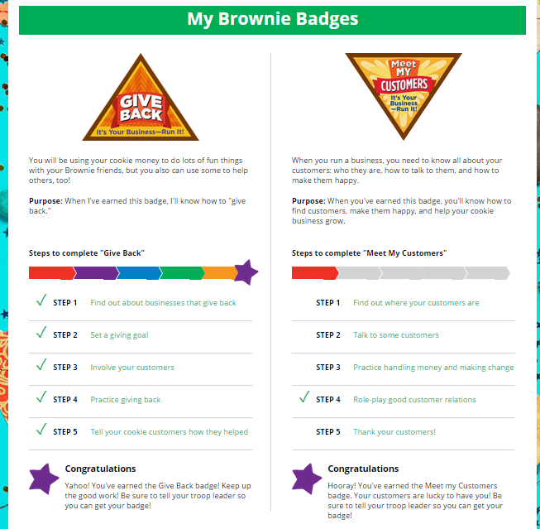
Digital Order Card 2.0
Notes:
Badges will show for whatever age level the girl is by her grade in eBudde.
They can complete these in any order
Clicking on the steps bring up the instructions on what to do to complete that step

Slide 39
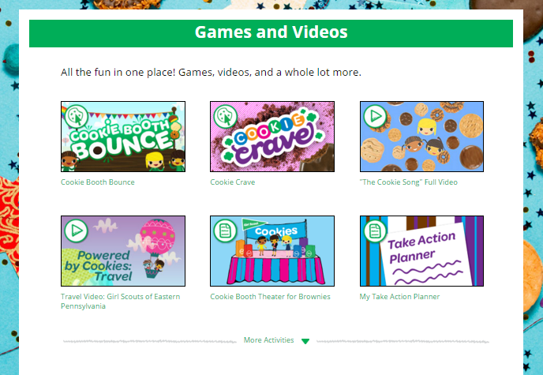
Digital Order Card 2.0
Notes:
EMBED THIN MINT SNIPPET
Let’s talk a little about the games and videos page.
-this will be specific to each age level
-There are even more than you see here, Click the “More Activities” to see all of them (click to show example) to hide those, click “less activities” (click to go back to original view)
-some of them are just for fun, but lots will work towards earning badges. Note, completing the activity doesn’t automatically show it as completed on the badge pages.
(Optional, play Thin Mint snippet here)
You know what else is popular for girls? Online Quizzes. Juniors through Ambassadors will find lots of them like…

Slide 40
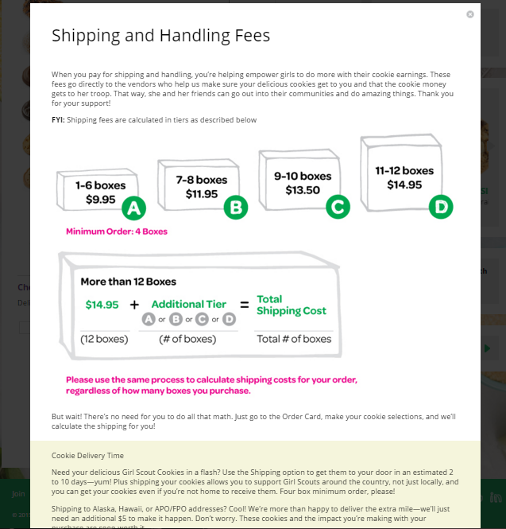
Digital Order Card 2.0
Notes:
Shipping information.
There is a 4 box minimum for shipped orders and for orders over 12, the rates “start over” again.
The average order last year was a little over 7 boxes per customer!!

Slide 41
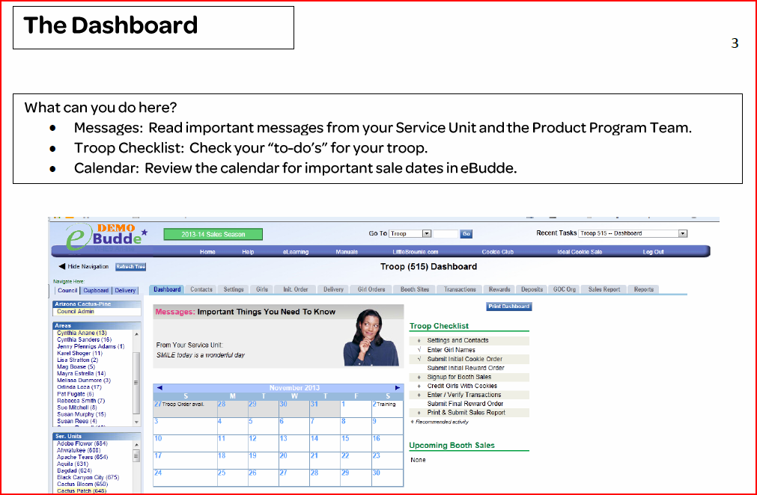
eBudde Info

Slide 42
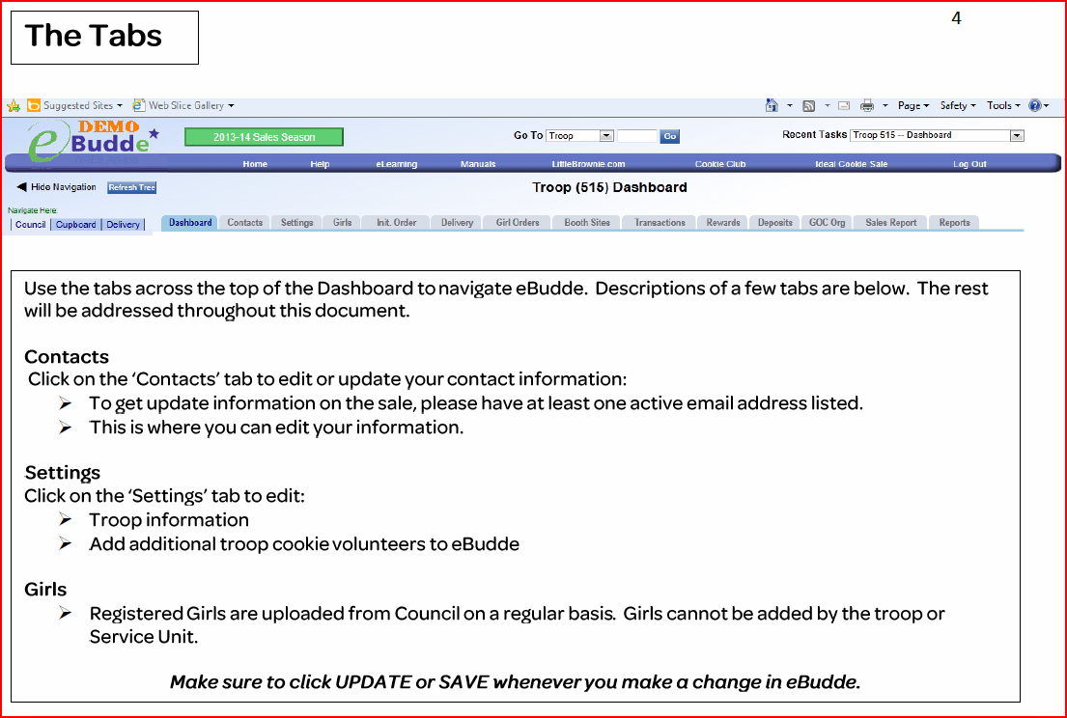
eBudde Info

Slide 43
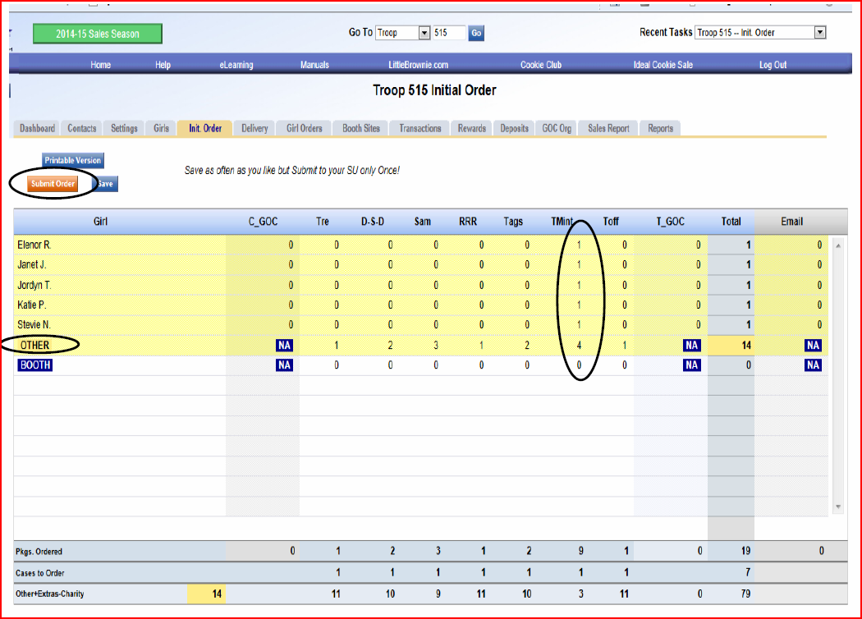
eBudde Info
Initial Order

Slide 44
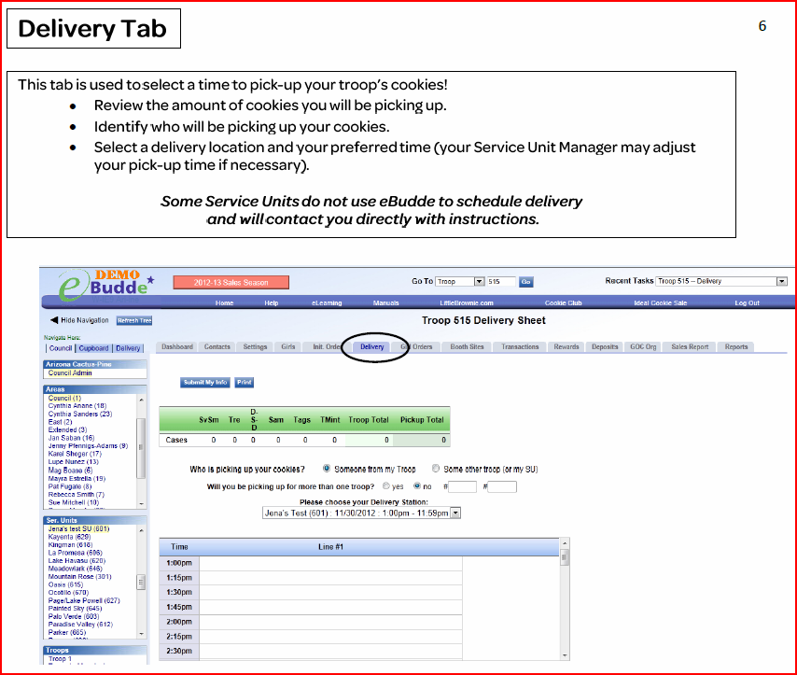
eBudde Info

Slide 45
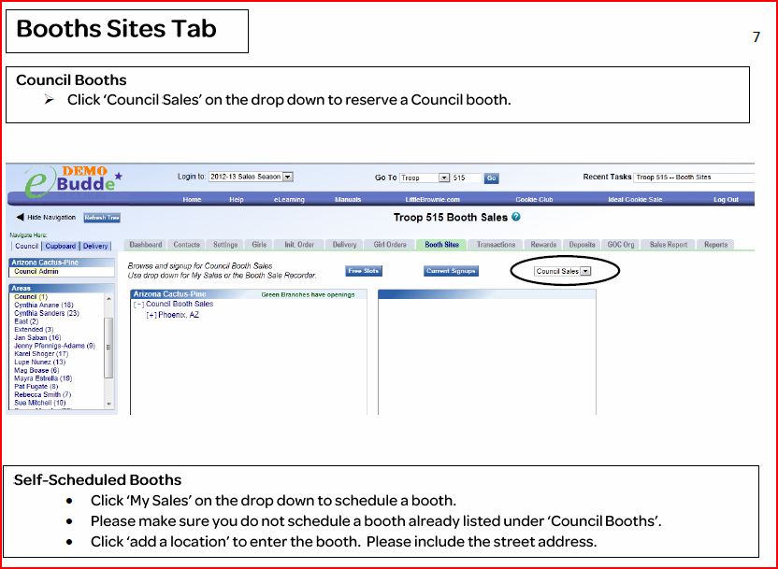
eBudde Info

Slide 46
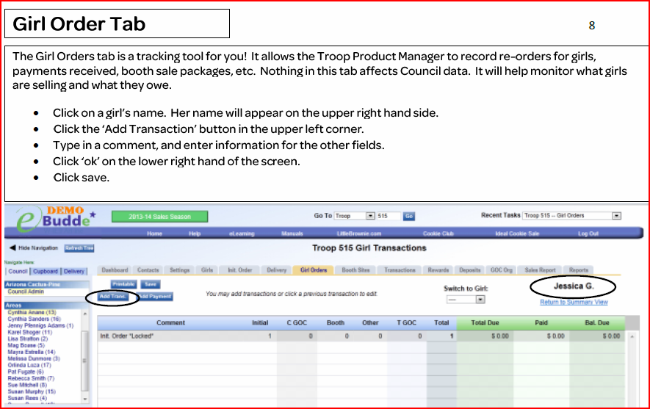
eBudde Info

Slide 47
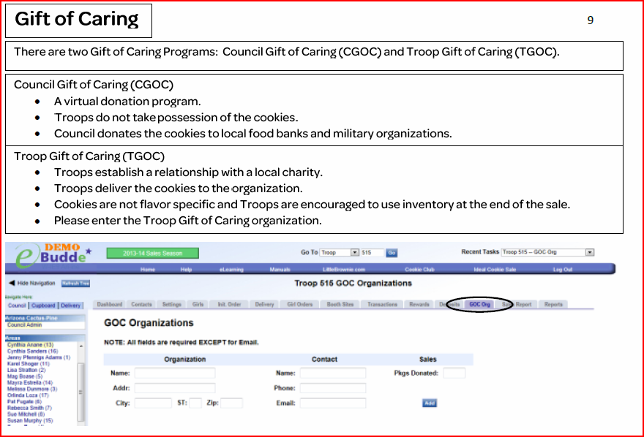
eBudde Info

Slide 48
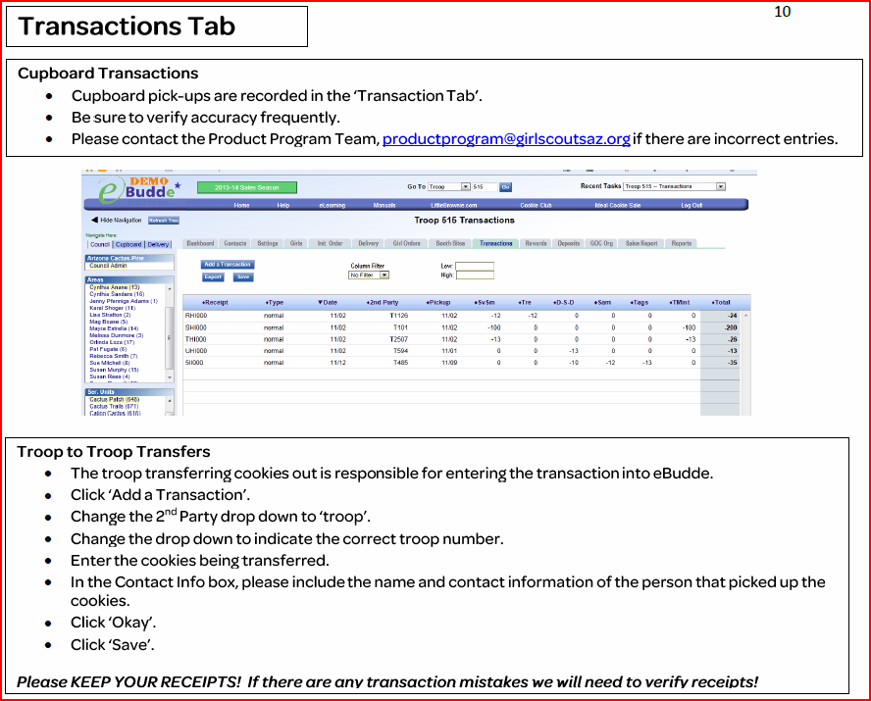
eBudde Info

Slide 49
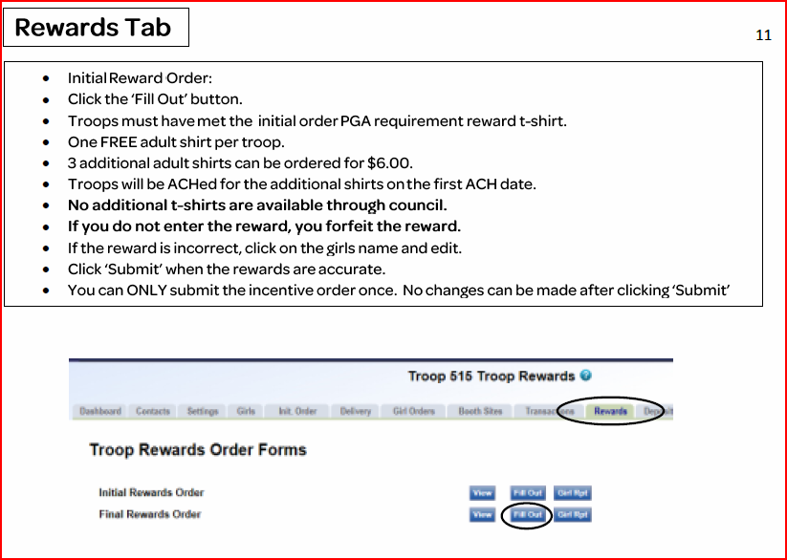
eBudde Info

