Slide 1
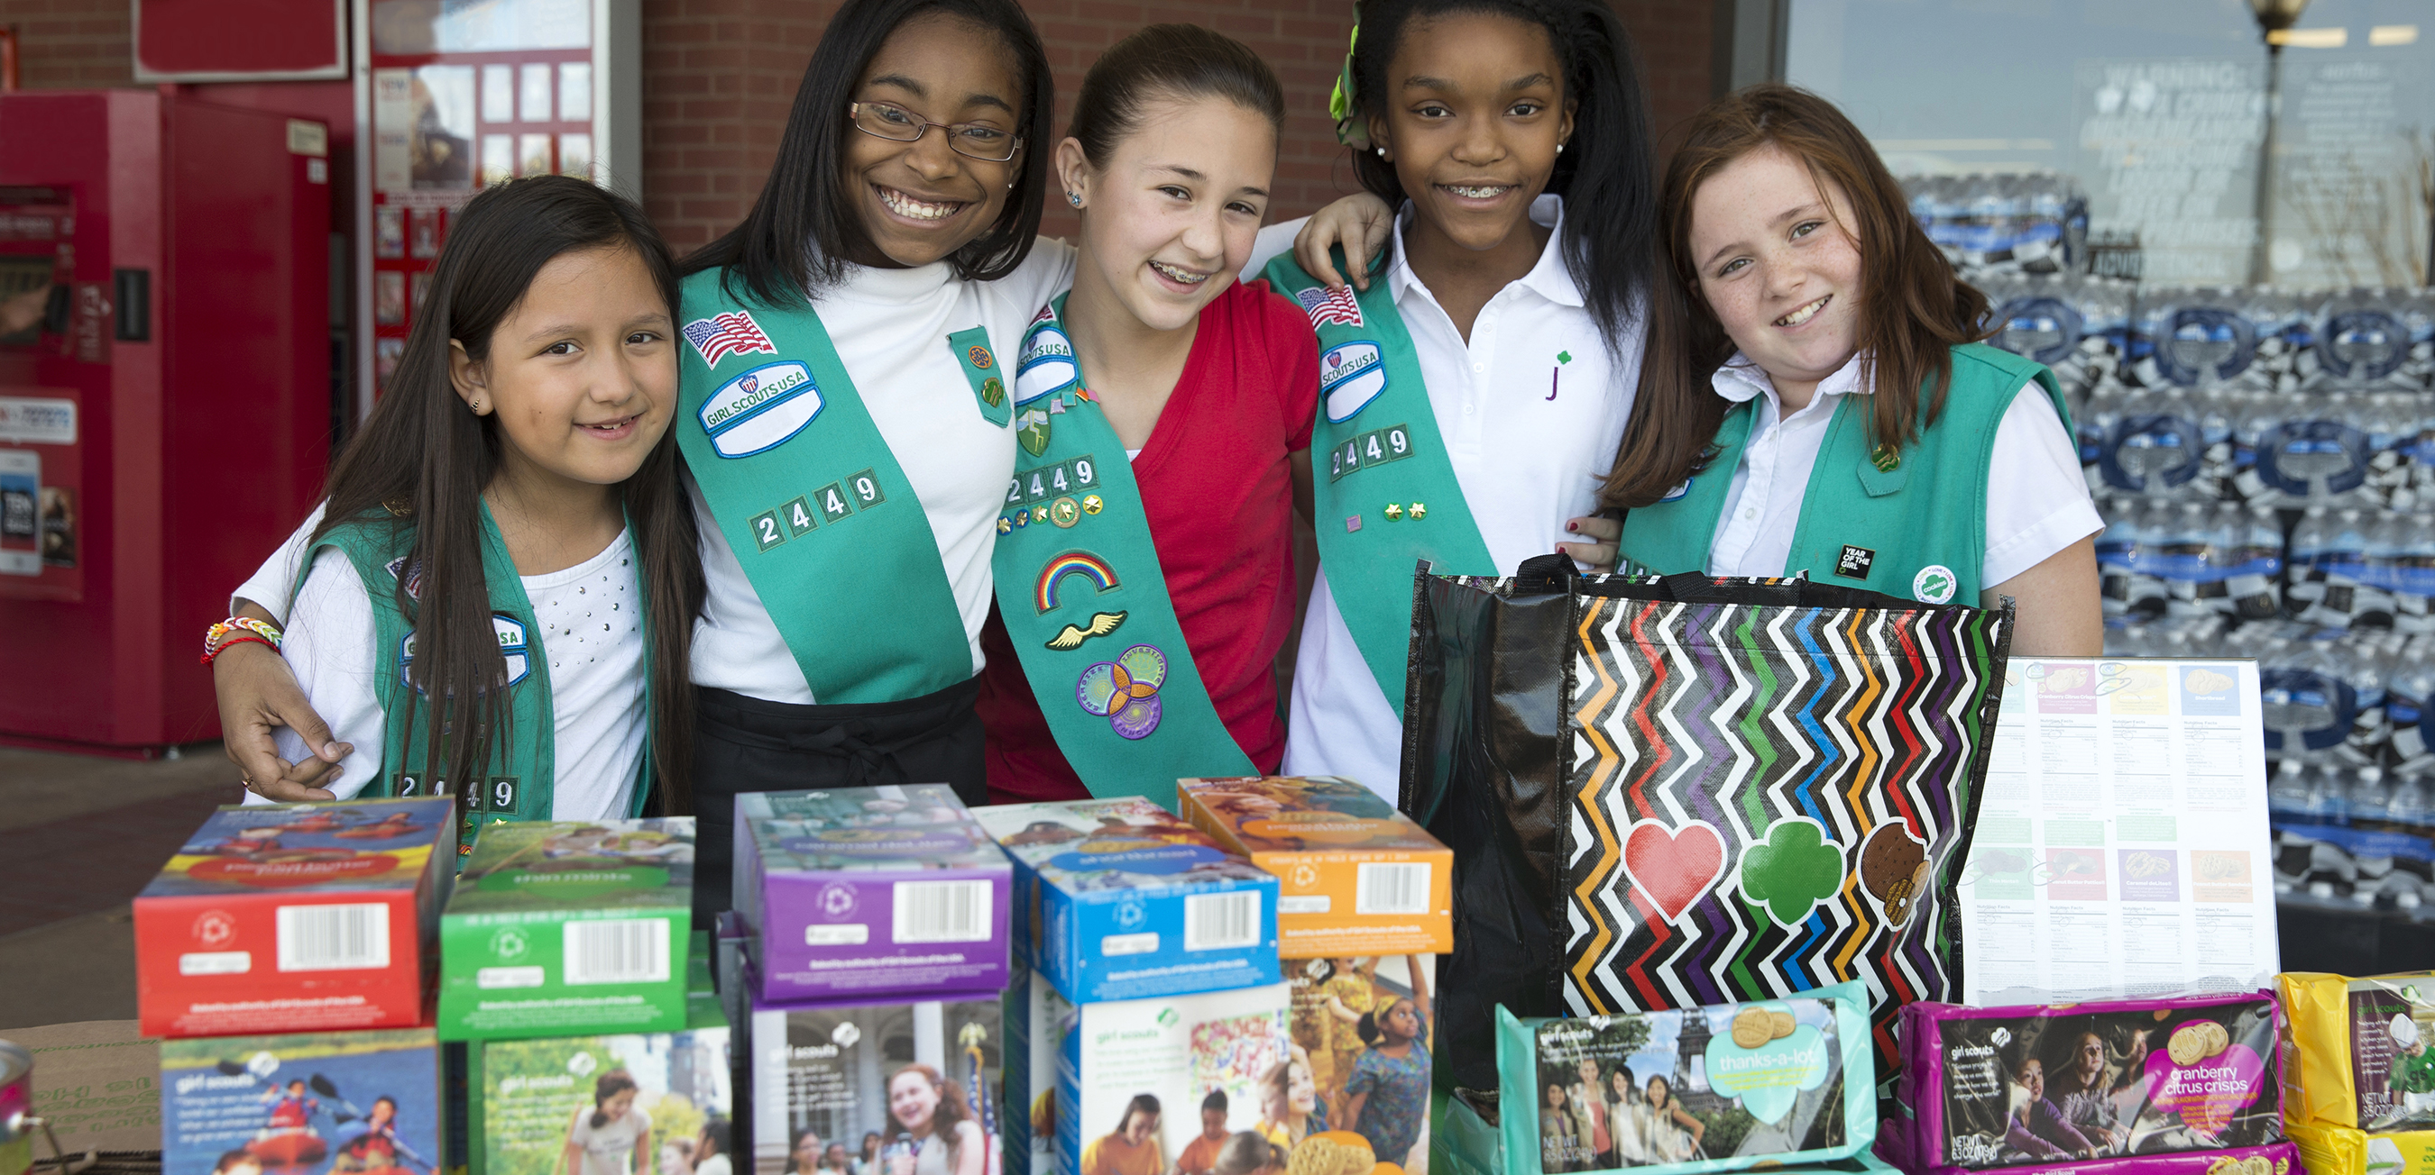
Digital Order Card 2.0
SU/Troop Training
Notes:
Welcome to Digital Cookie 2.0 training.

Slide 2
Agenda:
What is the Digital Order Card?
Service Unit and Troop Dashboard
The Girl Experience in Digital Cookie
Extended Information

Slide 3
Digital Order Card 2.0
What is it?

Slide 4
Digital Order Card 2.0
Service Unit and Leader View
Logging In

Slide 5
Digital Order Card 2.0
Troop leader/SU registration process
Scenario 1
Adult is a SU Cookie Person, not a parent or leader
Volunteer gets email
Clicks on link to go to digital cookie
Sets password and logs in
Watches safety video (even if no girls)
Signs Terms and Conditions for volunteer
Is taken to the SU Dashboard
Notes:
This is the process an adult volunteer without girls uses to log in to DOC.
Let’s take a look at each of the steps.
No need to commit this to memory, the system walks you through the process every step of the way and it won’t take more than a few minutes.

Slide 6
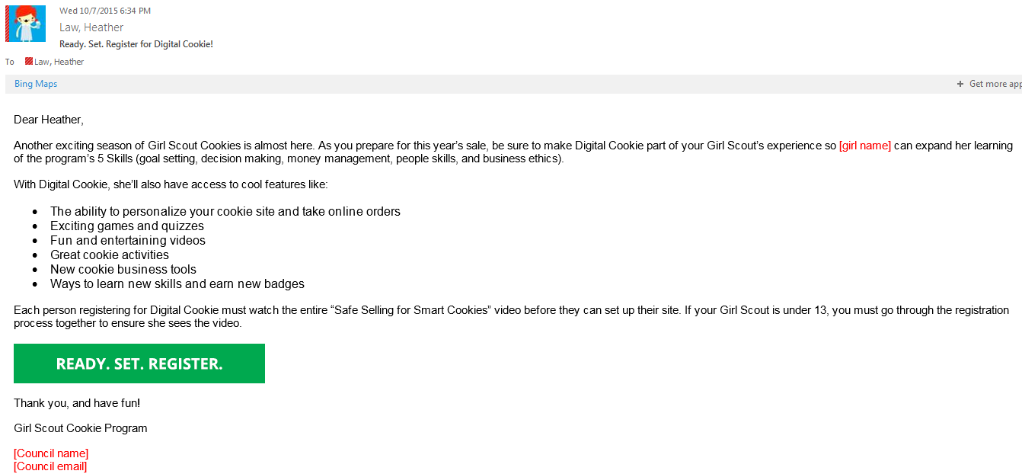
Digital Order Card 2.0
Notes:
First step, you’ll receive the registration email. All you have to do is click the green button.

Slide 7
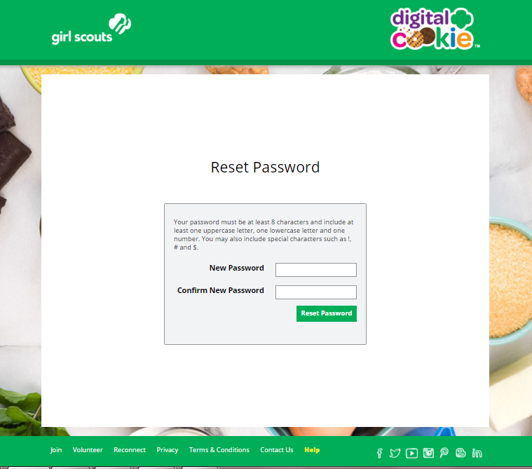
Digital Order Card 2.0
Notes:
Update screen
Their first time someone logs in will require them to set their password. The screen will say something more representative of setting password, not just reset.

Slide 8
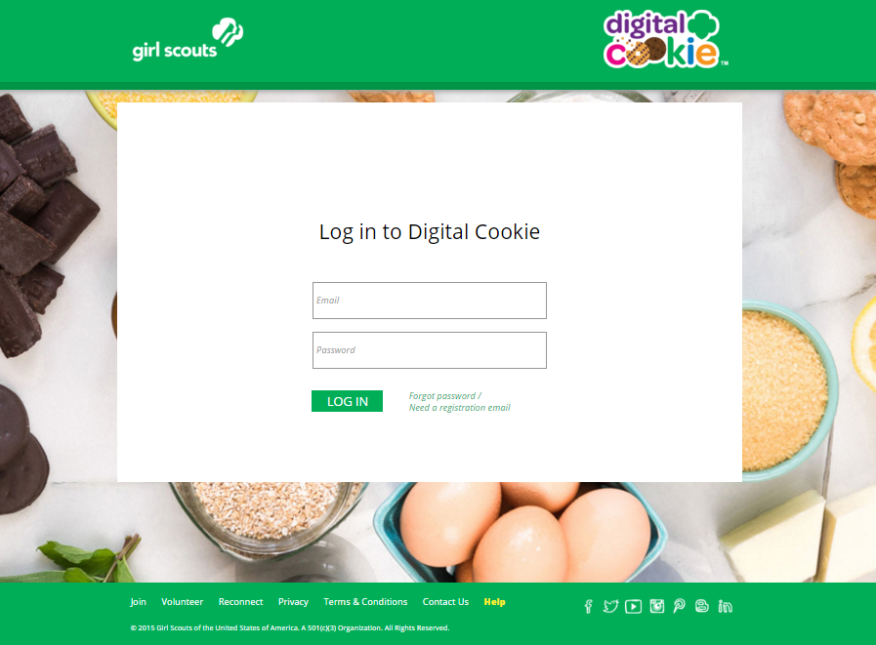
Digital Order Card 2.0
Notes:
Then login using that password and the email address where you received the registration email

Slide 9
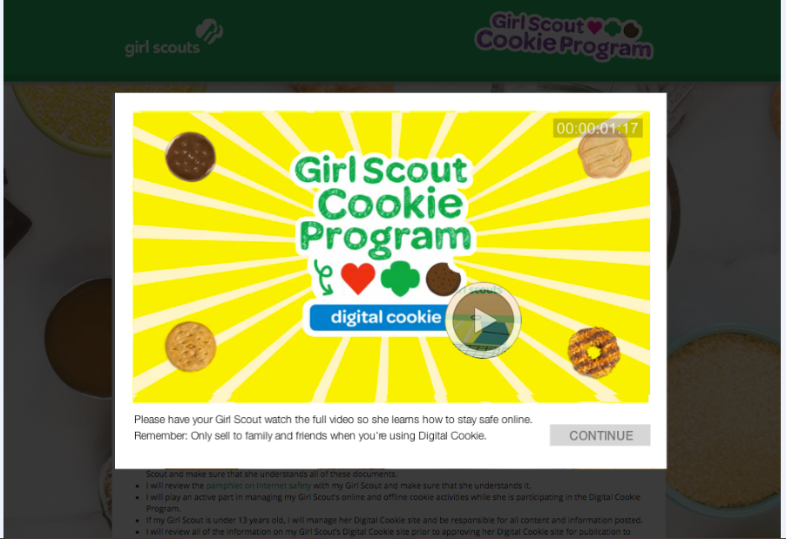
Digital Order Card 2.0
Notes:
You MUST view the safety video before proceeding any further. The video is really fun to watch. If for some reason you leave the site in the middle of watching it, you have to come back and watch the video before you go any further.

Slide 10
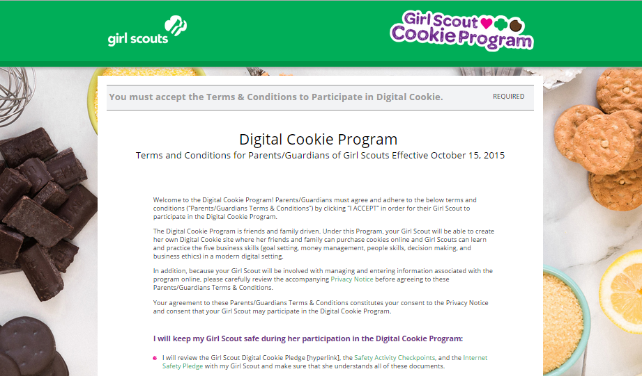
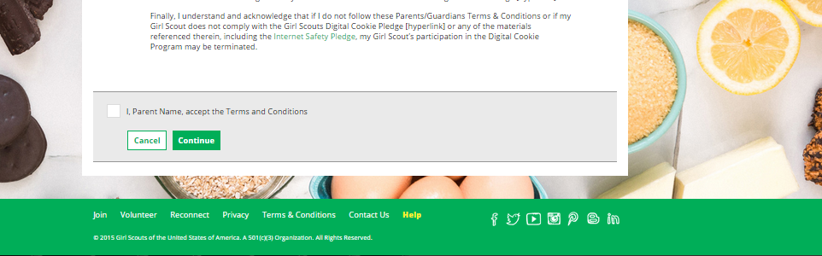
Digital Order Card 2.0
Notes:
UPDATE Screen
Then sign the Terms and conditions. This is only a representation of them.
After this, you would be taken to the SU dashboard

Slide 11
Digital Order Card 2.0
Troop leader/SU registration process
Scenario 2:
Adult is a parent of a girl over 13 AND a troop leader or SU Cookie Manager
1. User gets the Service Unit registration email (highest level in the hierarchy email only)
2. Clicks on link to go to digital cookie
3. Watches safety video
4. Signs T&C’s for volunteer
5. Signs T&C’s for parent
6. Chooses role from drop down
7. Chooses parent role
8. Registers girl(s)
9. Is taken to the parent dashboard
Notes:
For volunteers (SU or troop) who are also parents, there are a couple of extra steps.
First, we’ll look at it for parents of girls over 13.
The differences between this and the previous scenario are signing an extra T & C as the parent and selecting your role on logging in.
Volunteers who are also parents should login as a parent the first time they login. Let’s take a look.

Slide 12
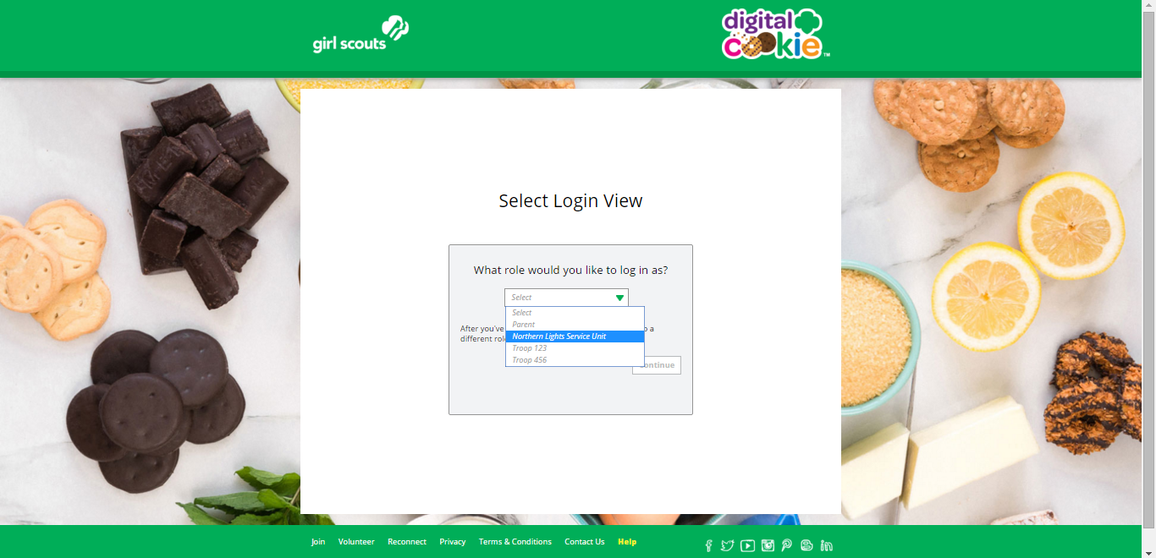
Digital Order Card 2.0
Notes:
Here is the Role selector screen that any volunteer will see during registration process and every time logging in after that. You can easily switch between roles at the top of the screen once logged in.
NOTE!! If you have a different email address for eBudde login (volunteer role) then you do as the parent, the accounts will not be tied together and you can not move between roles without logging in and out.
On your first login, choose parent in order to finish the registration process.

Slide 13
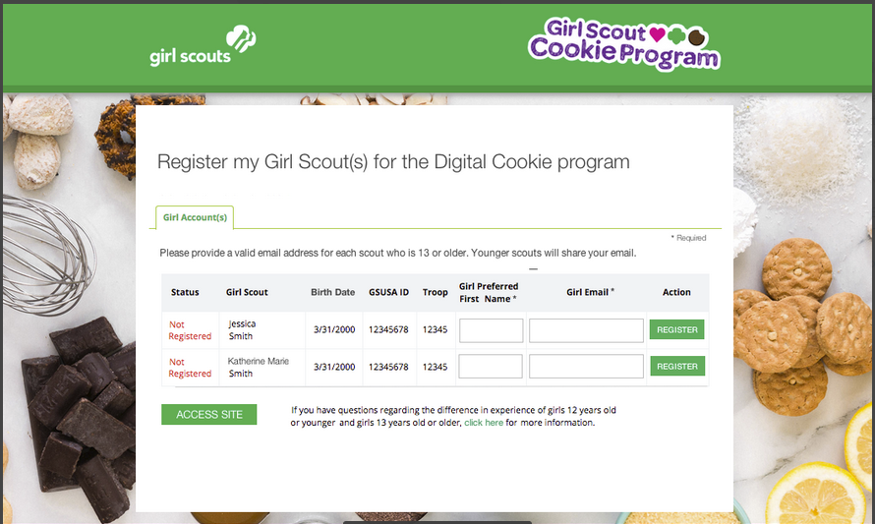
Digital Order Card 2.0
Notes:
Then, see a screen to register girls that looks mostly like this.
You will only be asked for the email for any girls over 13. If you get asked from leaders or parents about this because their 13 year old doesn’t have an email or they don’t want to use it, the parent can choose to set up an email account and not give the girl the password, just check the email themselves for the initial registration email.
Also note, the email address they use for the over 13 girl can’t be the same for anyone else in DOC

Slide 14
Digital Order Card 2.0
Troop leader/SU registration process
Scenario 3:
Adult is a parent of a girl under 13 AND a troop leader or SU Cookie Manager
1. User gets the Service Unit registration email (highest level in the hierarchy email only)
2. Clicks on link to go to digital cookie
3. Watches safety video
4. Signs T&C’s for volunteer
5. Signs T&C’s for parent
6. Signs Girl Pledge on behalf of the girls
7. Chooses role from drop down
8. Chooses parent role
9. Registers girl(s)
10. Is taken to the parent dashboard
Notes:
This is almost the identical process as the last scenario, difference is for a volunteer who only has girls under 13. They read and sign the girl pledge with their girl or girl(s) under 13, whereas girls over 13 do that themselves. Everything else is the same.

Slide 15
Digital Order Card 2.0
Service Unit and Leader View
Dashboard
Notes:
You survived the login process, which isn’t really that complicated. Let’s take a look at the SU dashboard. Which is nearly identical to the dashboard a troop leader would have.

Slide 16
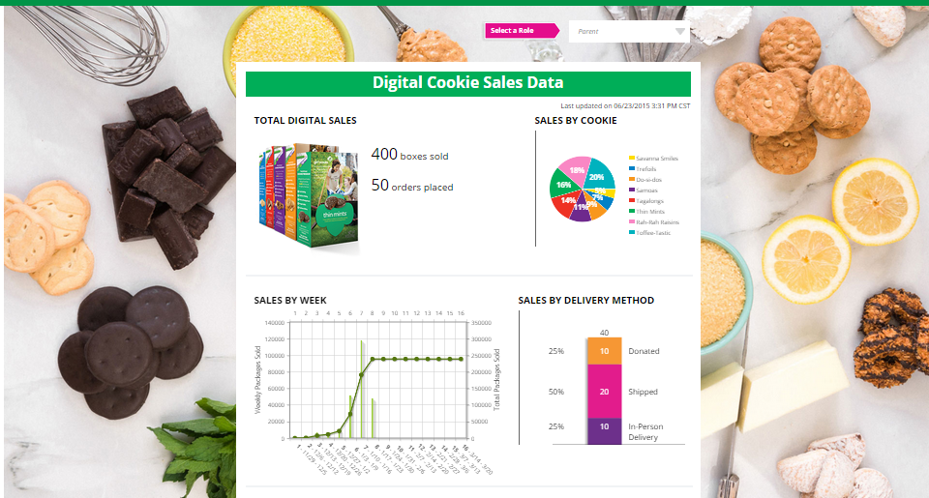
Digital Order Card 2.0
30
Notes:
When you are in, you’ll see this glance at your SU’s metrics. Pay no attention to the graph that shows as many raisin and toffee as mints! I doubt yours will look like that.
Note, if you have multiple roles you can easily switch between them using the role selector at the top. The role selector will be at the trop of all of your pages if you have multiple roles, allowing you to switch between roles..

Slide 17
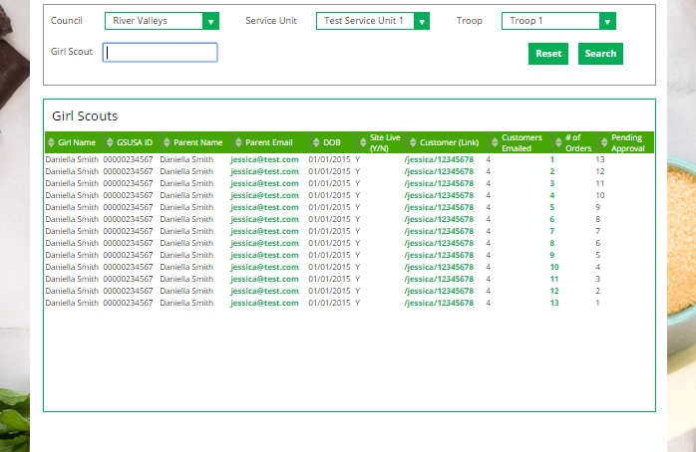
Digital Order Card 2.0
Notes:
The bottom of your dashboard is a list of all of the girls in your SU and their status. You can filter the info (talk about the categories) to see specific troops in your SU. Troop leaders/product managers have the same view but for their troops only.

Slide 18
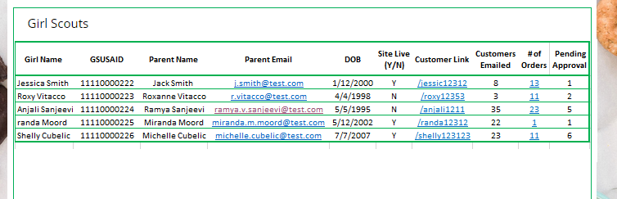
Digital Order Card 2.0
Notes:
Here’s a closer look at what a troop dashboard might look like. Or, an SU dashboard if they had selected a troop.
Everything functions the same for both troop and SU’s. The only difference is how many girls they can see.
In these new dashboards, leaders can do a lot to support their girls in DOC.
They can make sure girls have their site live, and if they don’t leaders can work with the girl and her family to see if she needs support.
Leaders can see if girls are sending out emails to customers and encourage them to send them periodically. She could also see if a girl were perhaps sending out too MANY emails and use it as a teaching opportunity about email spam.
But, the two fields I think will be most utilized are the last two. Let’s look at those.
NOTE-there won’t be any pending approval
The leader/SUCM would click on number of orders column

Slide 19
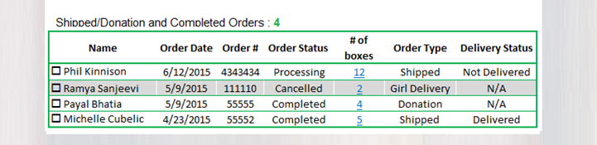
Digital Order Card 2.0
Notes:
Clicking on the orders will bring up a screen like this that allows the leader to see what orders the girl has had and the status of them all.

Slide 20
Digital Order Card 2.0
Leader Views-eBudde
Notes:
Let’s take a look at some additional information troop leaders will need to know when they have a girl in their troop get an order.

Slide 21
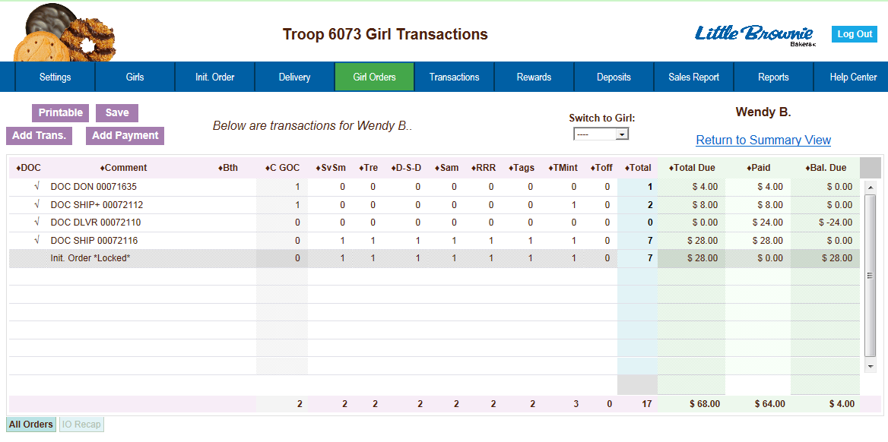

Digital Order Card 2.0
Notes:
Once an order has been placed and the payment clears, the information is sent to eBudde for your troop records. It will appear on the girl orders page as both whatever kind of cookies they ordered and how much money was deposited. There is nothing more the leader needs to do except adjust the amount she needs to deposit because the DOC amount is treated as a deposit for the full sales price of the box. (See next slide for example)
It should be noted that the minimum order for shipped cookies is actually 4 boxes. This screen is not an accurate representation of the minimums for shipping.

Slide 22
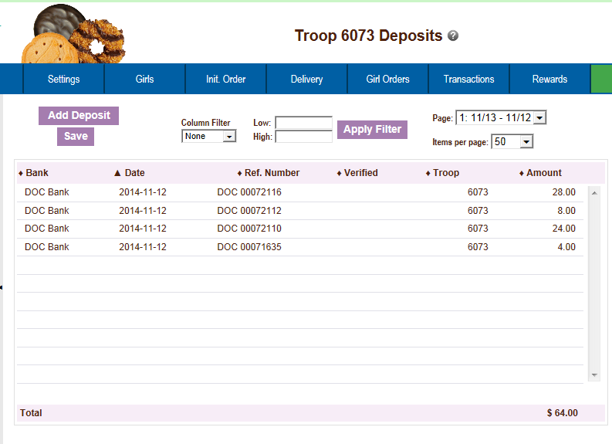
Digital Order Card 2.0
Notes:
All DOC deposits will be reflected on your deposits tab in eBudde as well. No need to do anything for those orders.

Slide 23
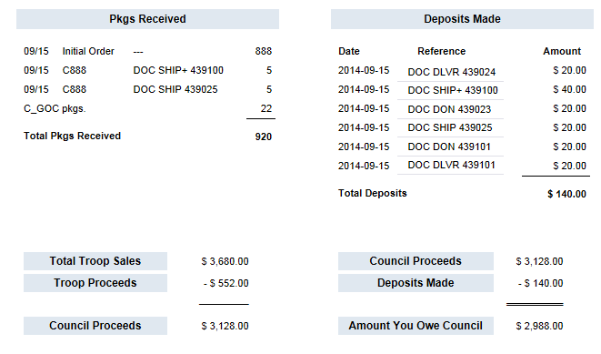
Digital Order Card 2.0
eBudde Sales Report
Notes:
Sales report
You can see how the transactions will be reflected on the sales report in ebudde and troops will adjust their deposits accordingly.

Slide 24
Digital Order Card 2.0
Girl Experience
Notes:
So, what does a girl/parent see when they are logged in? Note, unless you are also a parent, you don’t have any of these screes. But, you’ll have your notes and this presentation!

Slide 25
Digital Order Card 2.0
Girl (parent) gets registration email
Girl sets up site
Notes:
You’ve seen the registration process in probably painstaking detail. But, once the parent is in (or you if you are also a parent), what happens?
On a day determined by your council, everyone who is set up to use DOC will get a registration email. You only get one, and you get the one for the highest level you are. So if you are SUCM, you get one for that no matter what other roles you have.
When a parent only clicks on the email and completes the login process, they are taken to the girl’s site setup.

Slide 26
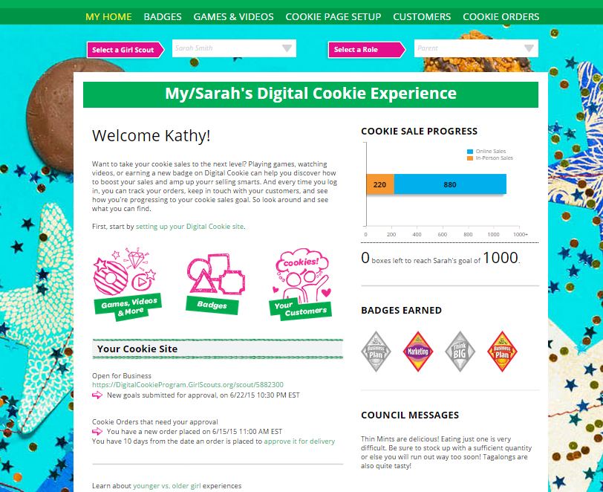
Digital Order Card 2.0
Notes:
This is a girl’s home page.
Let’s look at a tour of the features of this page.
Navigation bar
Multiple girls
Role selector
Graphic link to parts of the site
Badges
Cookie store link
Council messages
And finally-Site setup; also available from nav bar at the top
This is only the TOP part of the page though

Slide 27
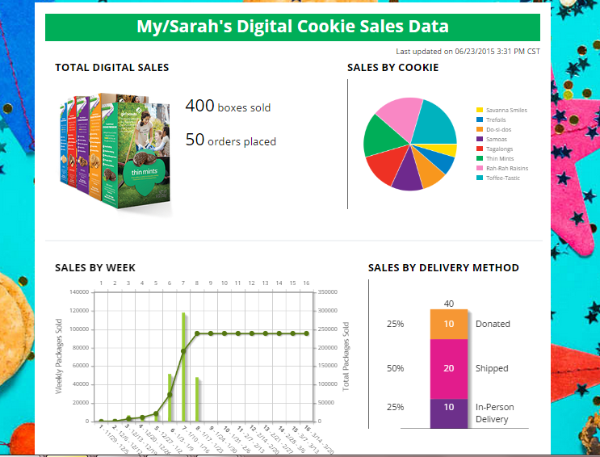
Digital Order Card 2.0
780
37
780
20.9%
163
69.9%
545
9.2%
72
30
Notes:
The bottom part are charts of her progress. This is such a great tie back to everyday skills. If she has already learned about pie charts and graphs in math class, this will be easy. If she hasn’t, when she does learn about them in school, she’ll be a pro already after having seen them on her DOC page and learning about them.

Slide 28
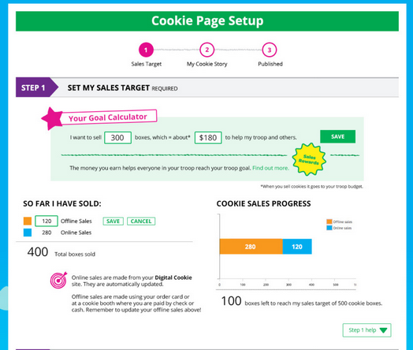
Digital Order Card 2.0
Notes:
Girl sets up her page
She enters her goal and the goal calculator does the math based on your council’s base proceeds.
Girls can see what rewards can be earned (If your council has shared the pdf of your cookie order card)
Online vs offline sales progress. Online calculation is automatic. Offline sales are entered by the girl herself and they are combined to show her sales progress towards her goal.

Slide 29
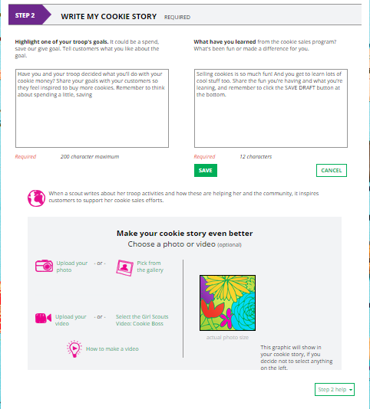
Digital Order Card 2.0
Notes:
Here is where girls write their cookie stories and where they can upload photos or videos or use stock ones. The stock video is “Cookie Boss”, but the stock photos she can use are on the next page.
You can also see that there is a great video for girls on how to make a video!

Slide 30
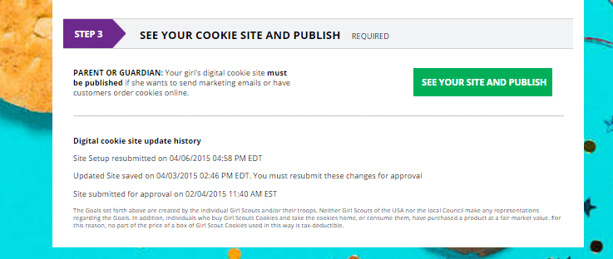
Digital Order Card 2.0
Notes:
And finally, girls click here for a preview of their site
Girl over 13 has button that says “see your site and submit for approval”

Slide 31
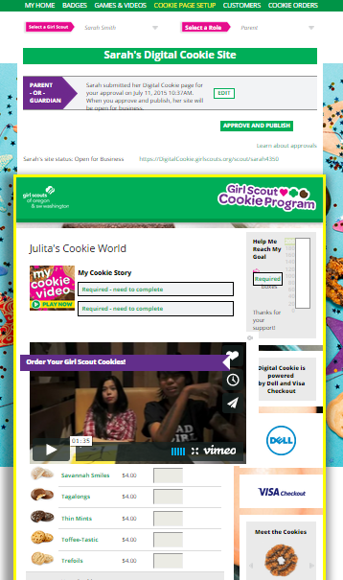
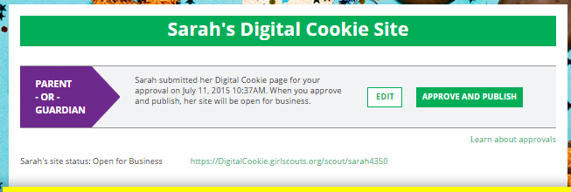

Digital Order Card 2.0
Notes:
This is the preview of the site (on the left).
Parents can edit from here and/or approve it.
Great. The site is ready. Now what? Lets get some customer emails out.

Slide 32
Digital Order Card 2.0
Girl (parent) gets registration email
Girl sets up site
Parent approves and publishes it
Girls build their customer list and send marketing emails
Notes:
Setting up a site is great, but then she has to actually publish it and send it out to customers.

Slide 33
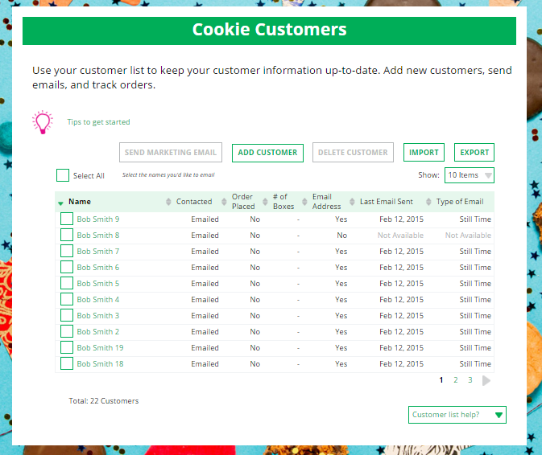
Digital Order Card 2.0
Notes:
Click on the customers tab at the top to see all of the customers they have.
Girls can add, delete, import and export customers from here. Adding a customer brings up a pop-up screen for girls to quickly enter new customers one at a time.

Slide 34
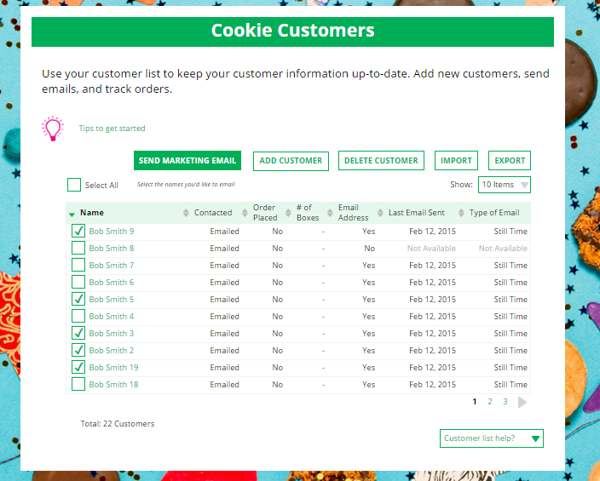
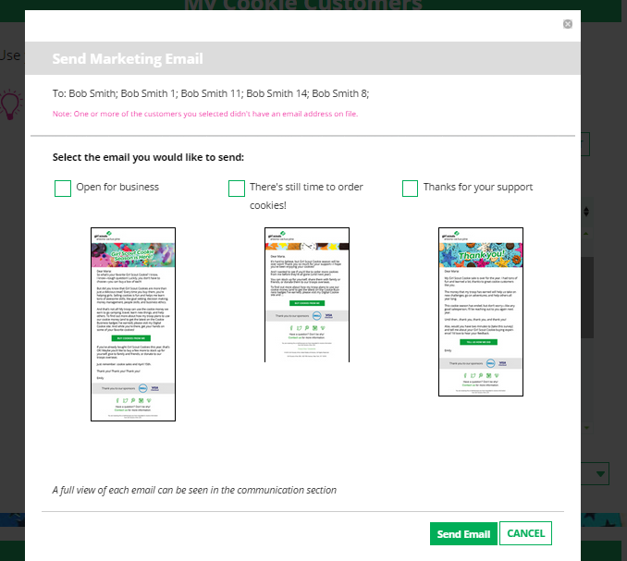
Digital Order Card 2.0
Notes:
Girls can also send customer marketing emails from here. They would click the customers they want to send an email to (hopefully noting who they have sent what emails to already) and click send marketing emails.
Then choose which email they want to send

Slide 35
Digital Order Card 2.0
Girl (parent) gets registration email
Girl sets up site
Parent approves and publishes it
Girls build their customer list and send marketing emails
Girls get orders
Notes:
Now-they have orders!

Slide 36
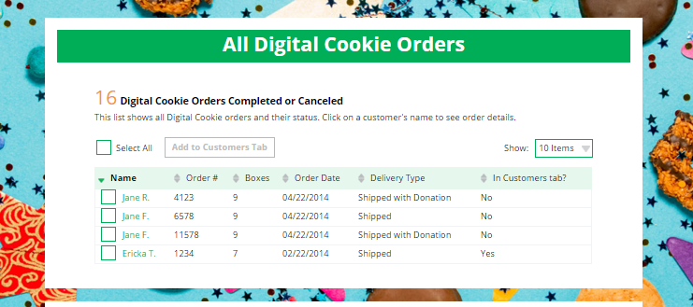
Digital Order Card 2.0
Notes:
Update screen for 4 not 16
If the parent clicks on one of the orders it will bring up the details for the order.

Slide 37
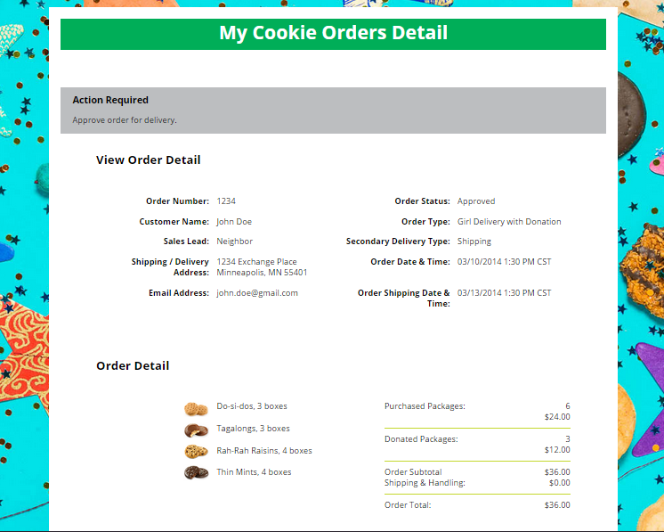
Digital Order Card 2.0
Notes:
The individual order screen looks like this.
At the time the order is placed, the information goes to eBudde as well. Leaders will have the information they need about that.

Slide 38
Digital Order Card 2.0
Extended Information
Notes:
A few other pieces of info

Slide 39
Digital Order Card 2.0
Shipping Minimums
Games/Videos/Learning
Notes:
Sales report

Slide 40
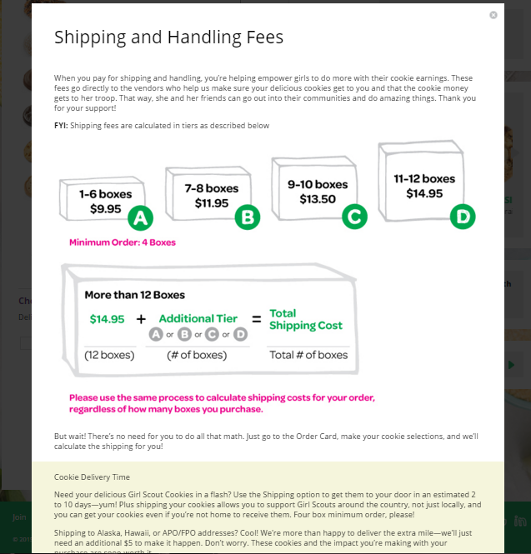
Digital Order Card 2.0
Notes:
Shipping information.
There is a 4 box minimum for shipped orders and for orders over 12, the rates “start over” again.
The average order last year was a little over 7 boxes per customer!!

Slide 41
Digital Order Card 2.0
Notes:
Badges and games & videos.
First, badges, girls will find the cookie related badges appropriate for their age level right in the DOC. They can click on the “badges” at the top or the “badges” icon in the middle of the page.

Slide 42
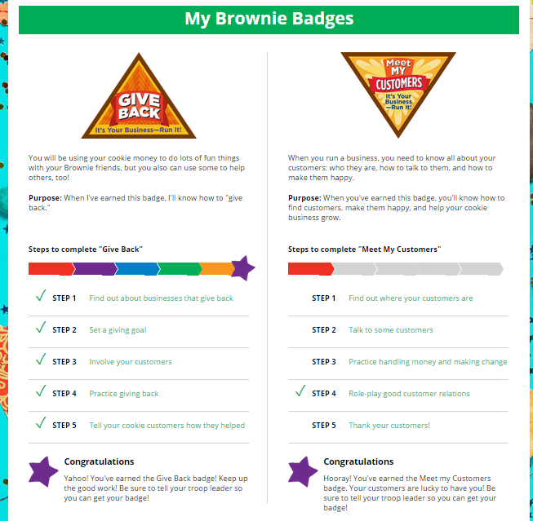
Digital Order Card 2.0
Notes:
Badges will show for whatever age level the girl is by her grade in eBudde.
They can complete these in any order
Clicking on the steps bring up the instructions on what to do to complete that step

Slide 43
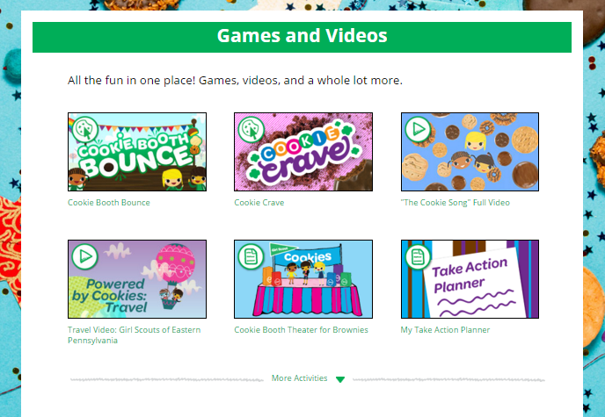
Digital Order Card 2.0
Notes:
EMBED THIN MINT SNIPPET
Let’s talk a little about the games and videos page.
-this will be specific to each age level
-There are even more than you see here, Click the “More Activities” to see all of them (click to show example) to hide those, click “less activities” (click to go back to original view)
-some of them are just for fun, but lots will work towards earning badges. Note, completing the activity doesn’t automatically show it as completed on the badge pages.
(Optional, play Thin Mint snippet here)
You know what else is popular for girls? Online Quizzes. Juniors through Ambassadors will find lots of them like…

Slide 44
Digital Order Card 2.0
Questions?

